Slide 1



Cloth Folding Mechanism
Yug Kansara - 180103094
V.Harshvardhan -180103095

Slide 2
Why Machine for folding clothes?
Since clothes folding is always a tedious process for most people, it is a good idea to produce a machine that can reduce the work and time of folding clothes

Slide 3
What goes in :
The Design process includes research in background information and relevant standards, needs specification, concept generation and selection, and ENGINEERING ANALYSIS

Slide 4
What can you fold:
- T Shirt
- Shirts
- Pants
- Any Rectangular or Square shaped cloth

Slide 5
Basic Idea
The plot is to get the cloth into a rectangular shape and then into smaller Square appropriate for packing

Slide 6
Then...
We fold the piece into a condensed form of it which is easy to store within a threshold space

Slide 7
The Blueprint :
Rear Handle
- Two Horizontal Flippers
- One Vertical Flipper
- Mechanism to rotate the flippers
Vertical
Flipper
Horizontal
Flipper
The Mechanism

Slide 8
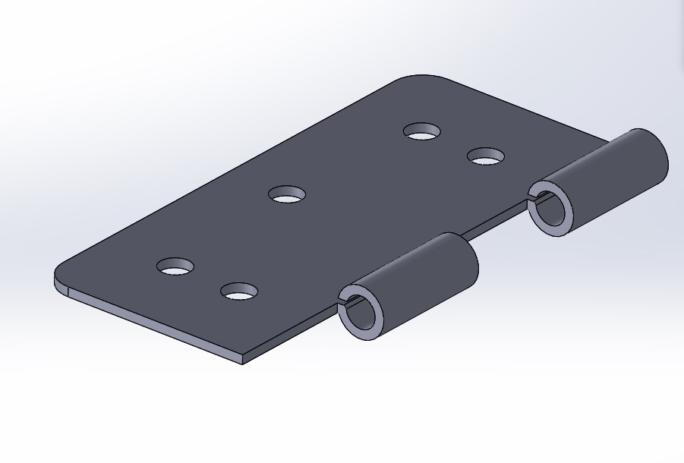
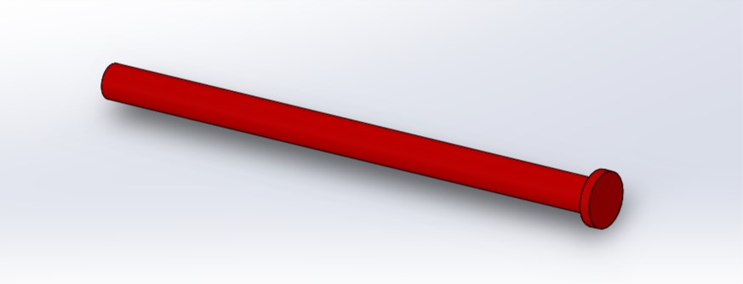
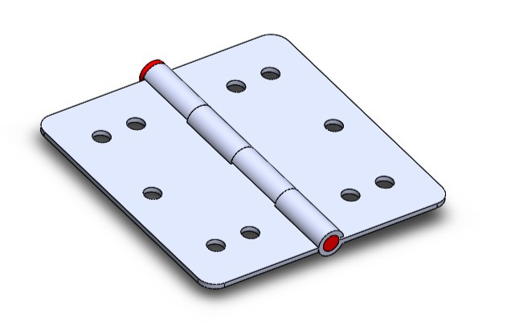
Hinge and it’s Components:

Slide 9
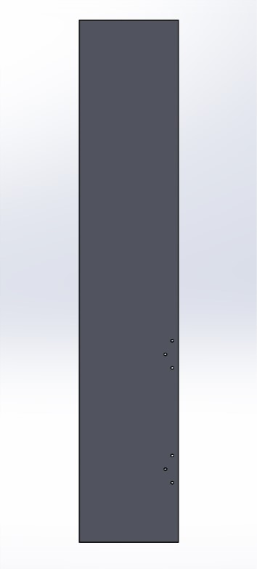
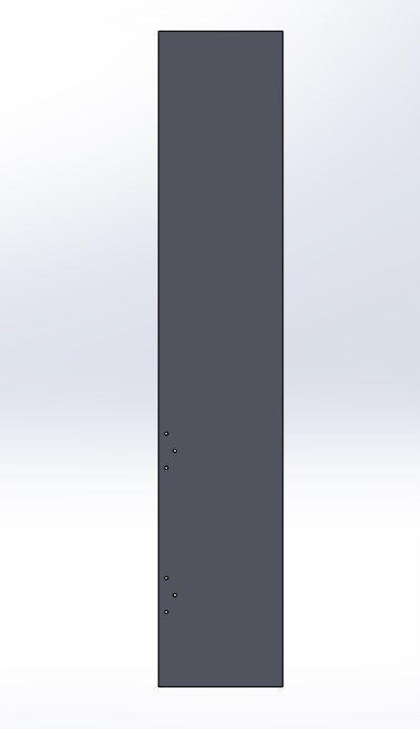
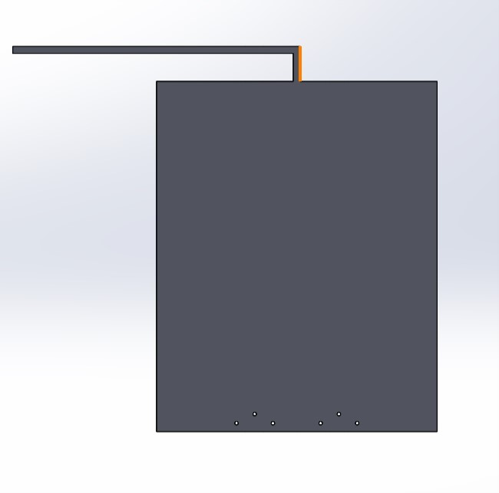

Machine Parts 1
Main Bed
Top flipper
Left flipper
Right flipper

Slide 10
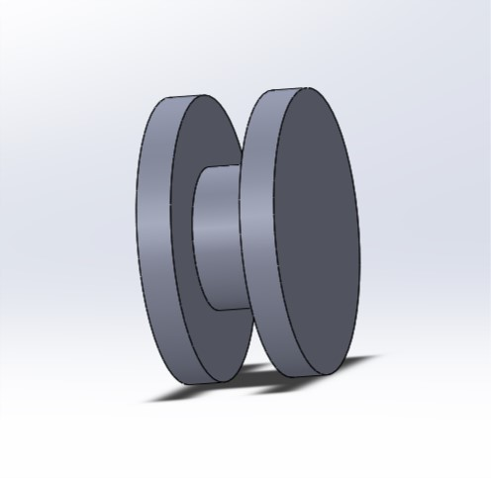
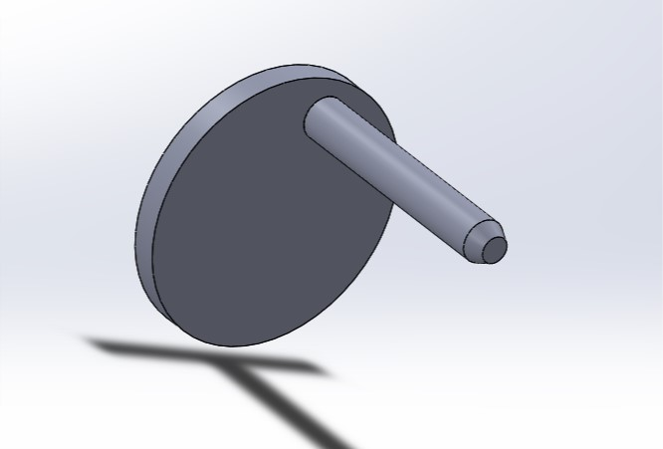
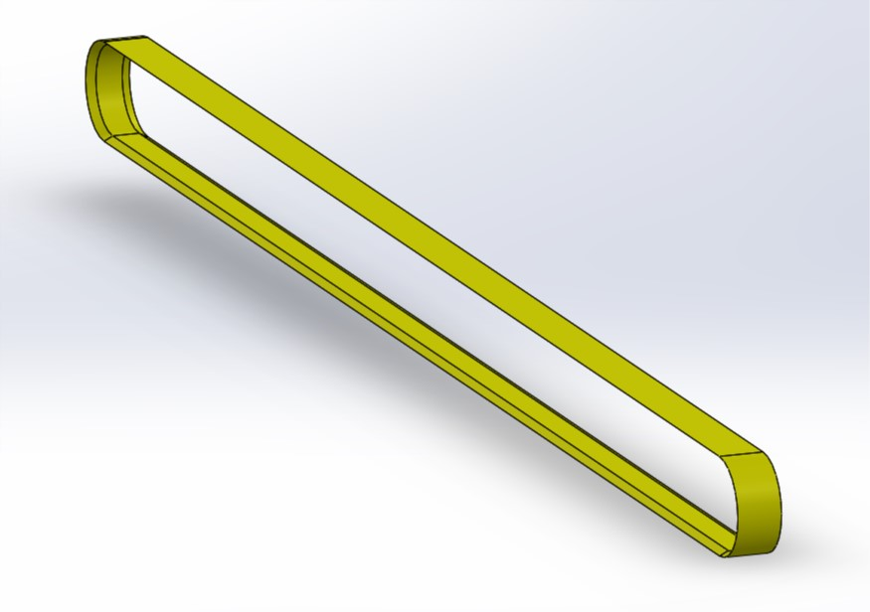
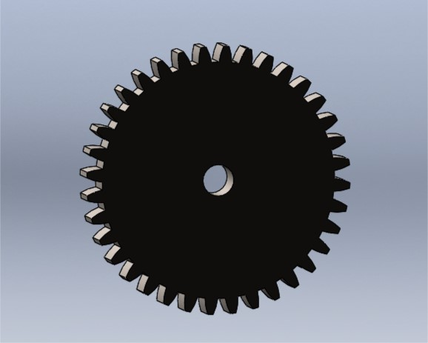
Machine Parts 2
Rubber Belt
Spur Gear
Belt Pulley
Input Controller

Slide 11
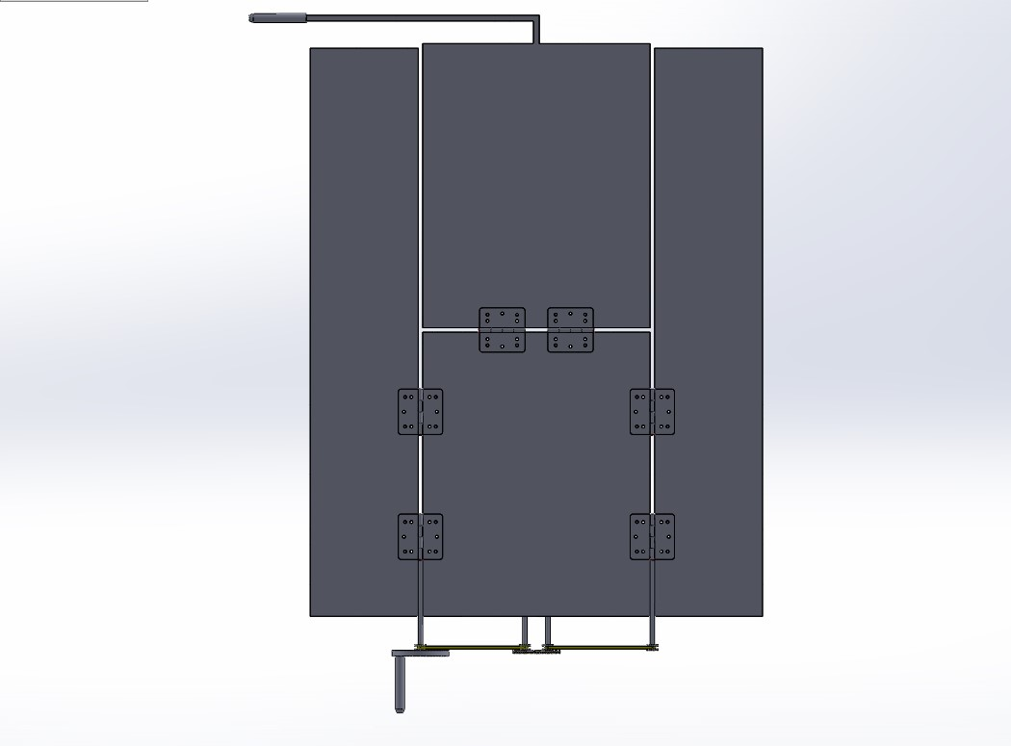
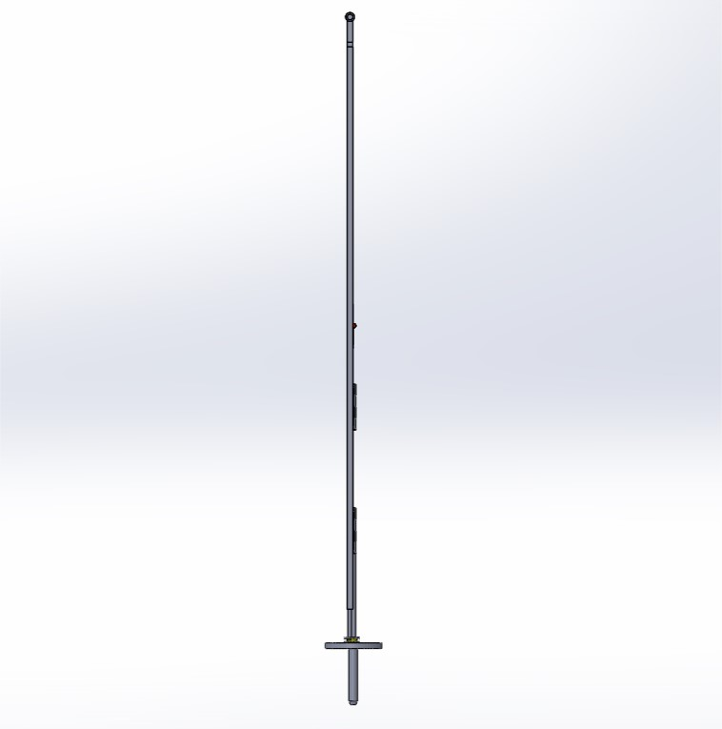
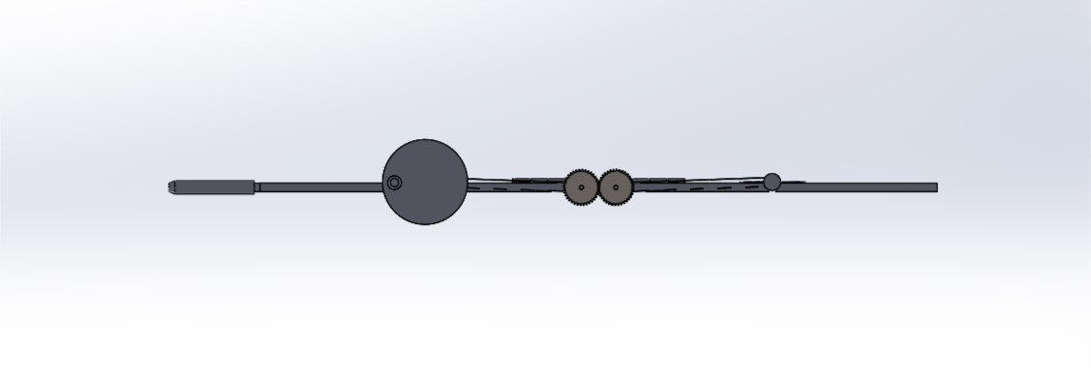
Assembled Machine

Slide 12
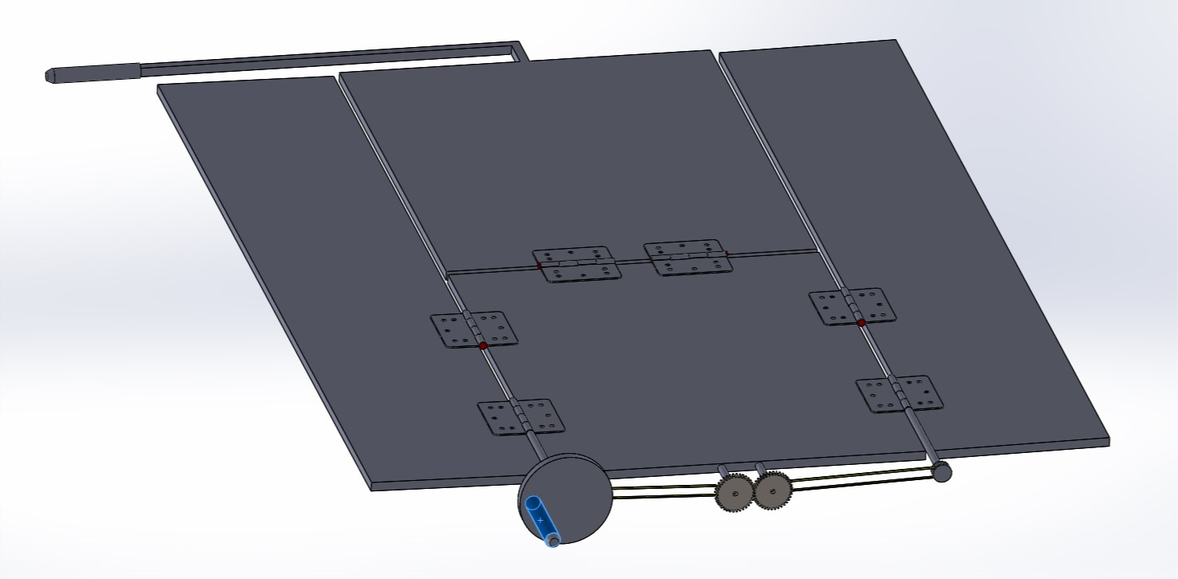
Assembled Machine

Slide 13
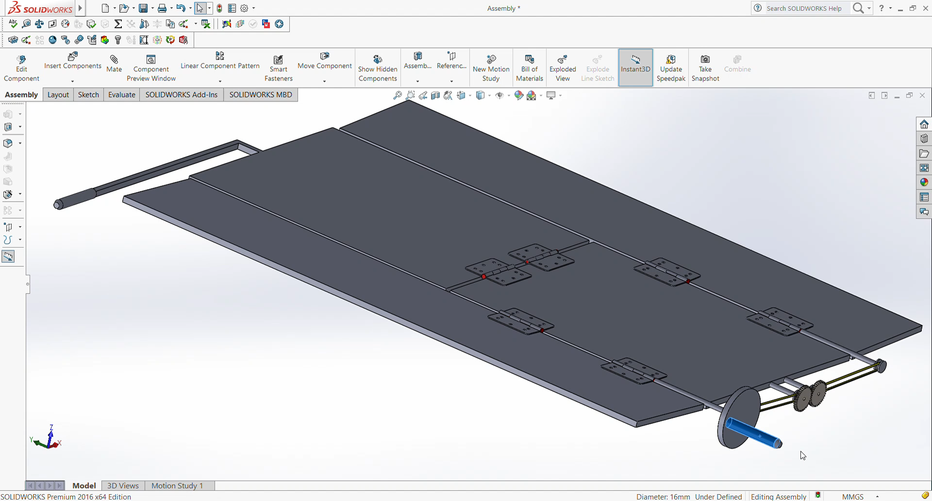
Model

Slide 14
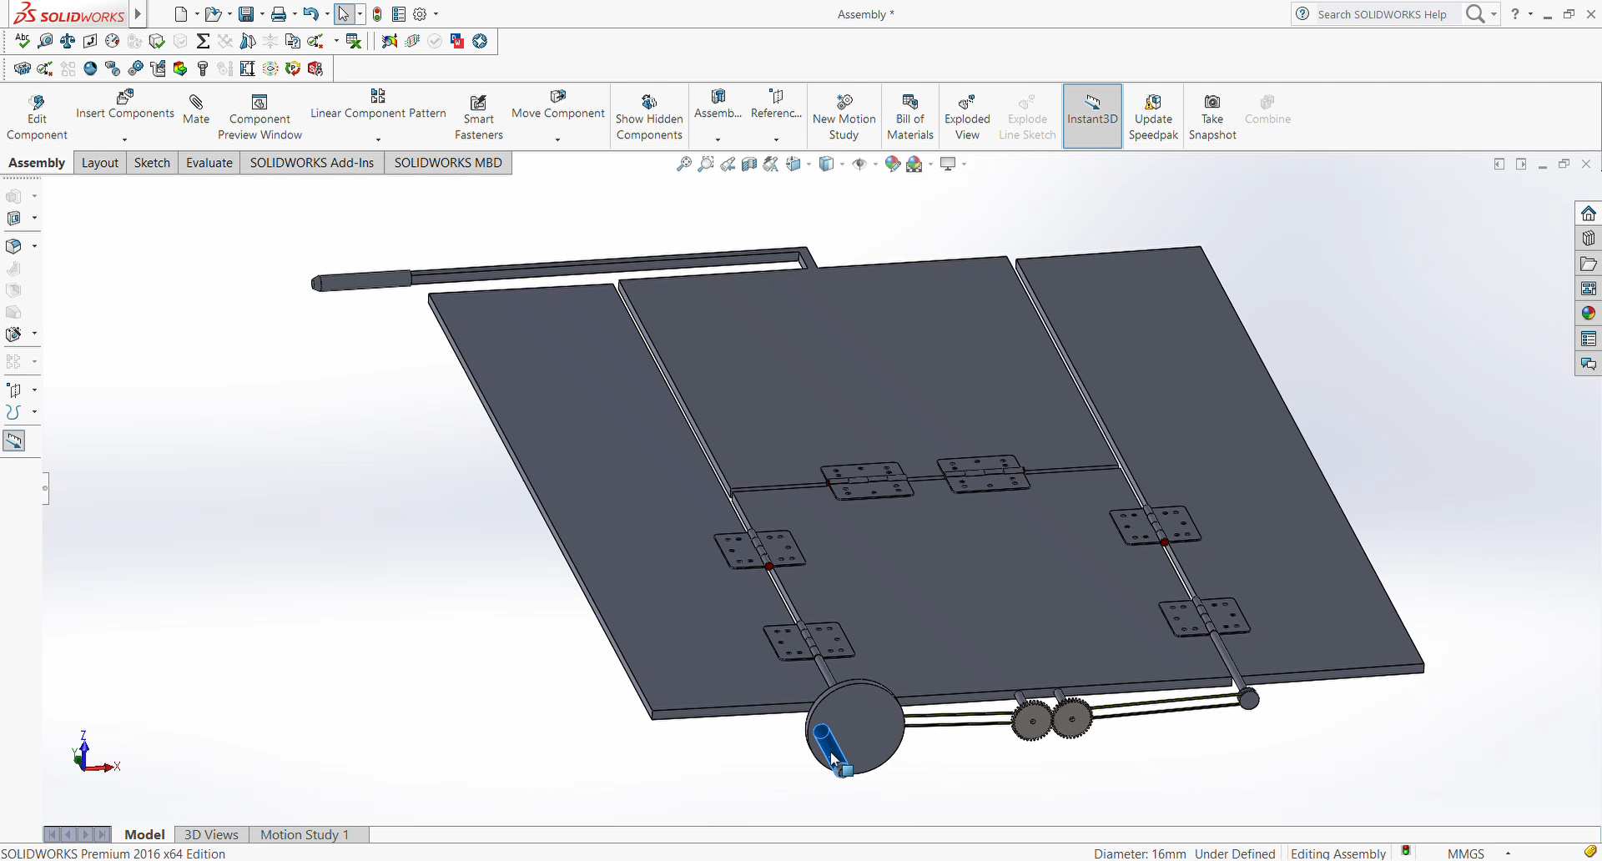
Kinematic Analysis 1
DOF- 2 (one for controller other for rear handle)
Joints used : 3 revolute pairs (lower pairs)
2 Gears coupled
Elements used : Door hinges, gears, 4 flat plates (various sizes)

Slide 15
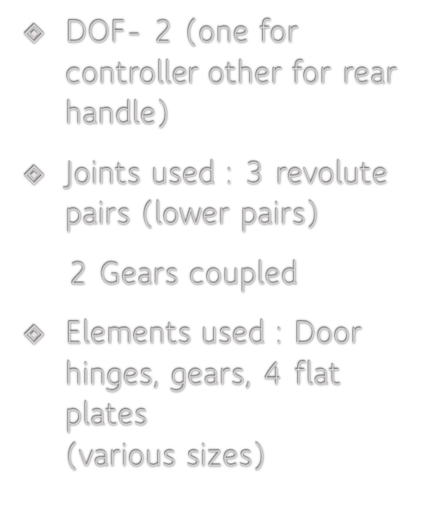
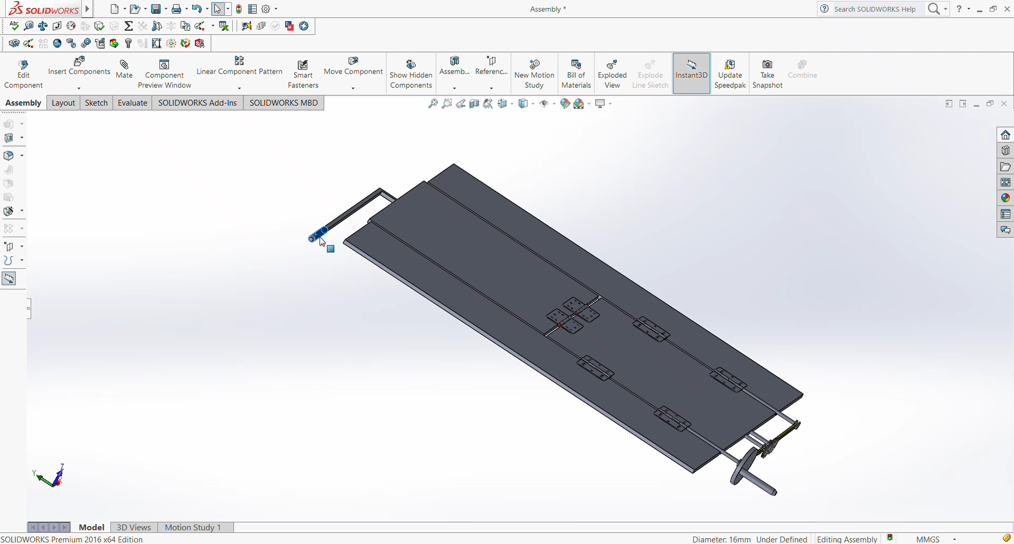
Kinematic Analysis 2

Slide 16
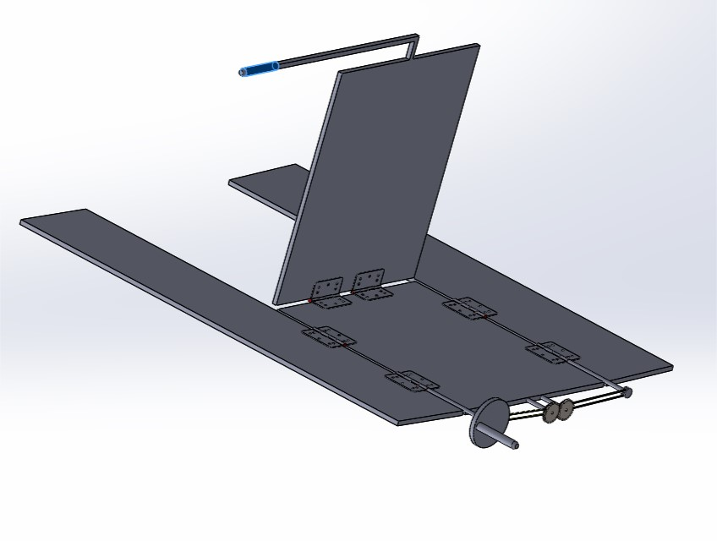
Kinematic Analysis 2 contd.
Hand of operator is also part of link 2
DOF = 3(2-1)-2(1)
= 1
Number of links are two because there in no relative motion between operator’s hand and the front flipper
2
1

Slide 17
Spur Gear Properties
Module - 1.125
No of teeth – 36
Pressure angle – 14.5
Face width – 5 mm

Slide 18

Our Inspiration

Slide 19
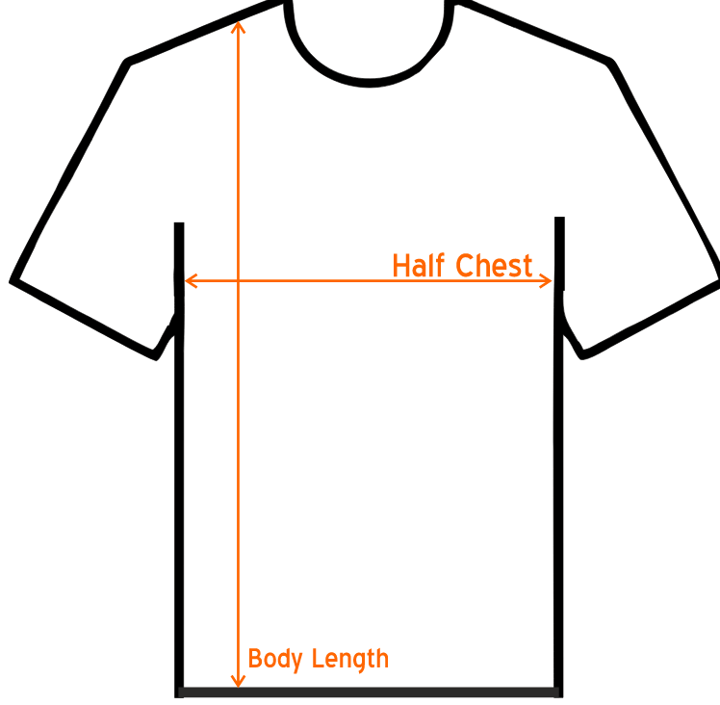
Folding the Tshirt

Slide 20
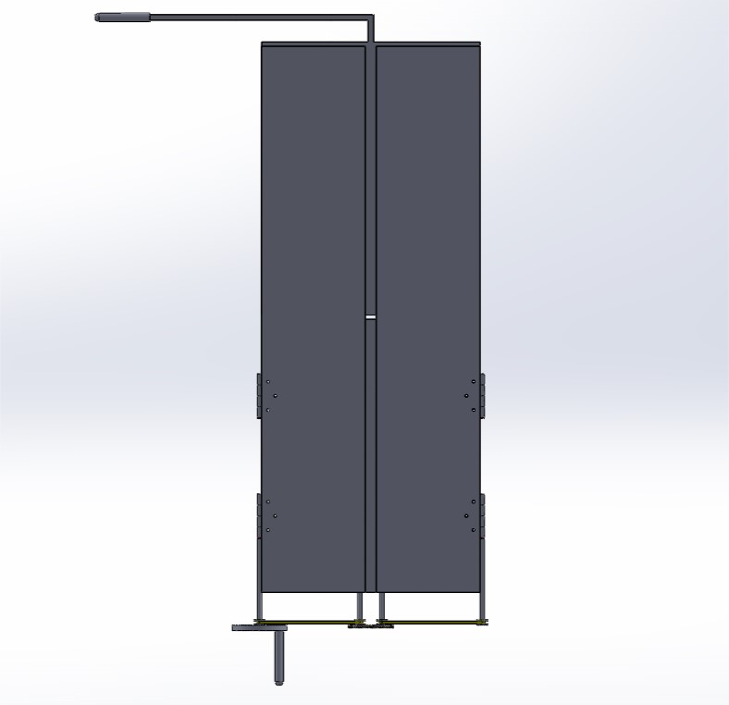
Folding the Horizontal Flippers(Tshirt)

Slide 21
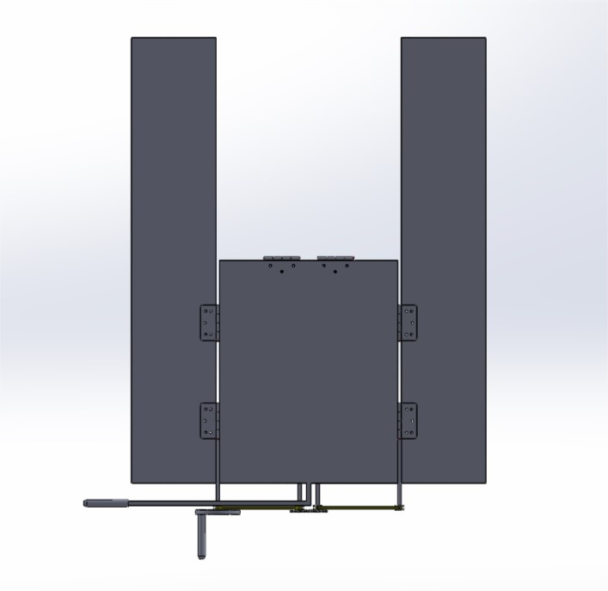
Folding the Vertical Flipper

Slide 22
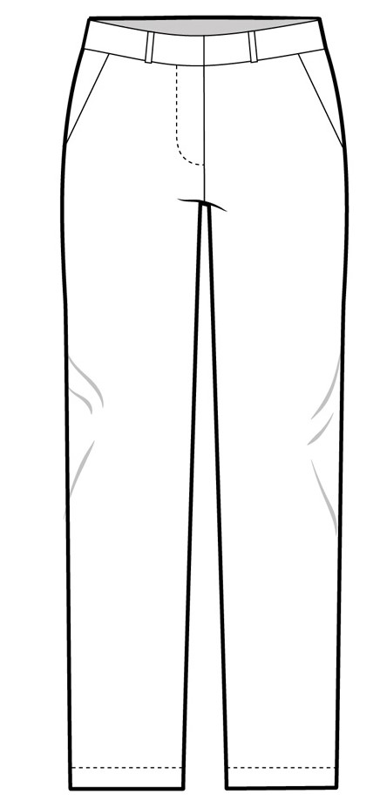
Folding Pants
We can Fold two Pants at one time

Slide 23
Folding the Horizontal Flippers

Slide 24
Folding The Vertical Flipper

Slide 25
Pros and Cons
Pros
- Simple and sleek design
- Output cloth from machine is thin and uniform
-Can be used with variety of materials
-Ideal for household use
Cons
-We have to fold sleeves ourselves
-We need to fold pants one more time(for ideal fold)

Slide 26
To make a real world model
Material: Plastic and Rubber(for belt) to make machine light weight
Features : We have tried to make machine as simple as possible. It is light weight, affordable and easy to use. Machine should be scaled accordingly to the purpose of use with one constraint that twice the width of side flaps should not exceed the width of main bed.

Slide 27
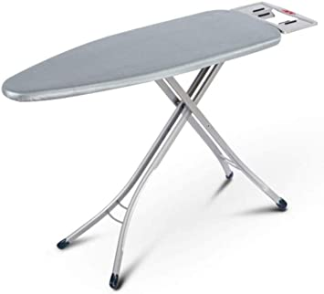
Also….
We can place the machine on Pressing Table to be more efficient., by pressing the cloth and then fold it.

Slide 28
Note
We tried to condense the cloth even further by introducing another machine at the bed of the previous which performs similar task.
It increased the complexity and we wanted to keep machine as simple as possible so that it remains easy to use.
Also it was hard to give input to smaller machine, which might crash the machine if the input weren’t given delicately, so we considered to discard further condensation.

Slide 29

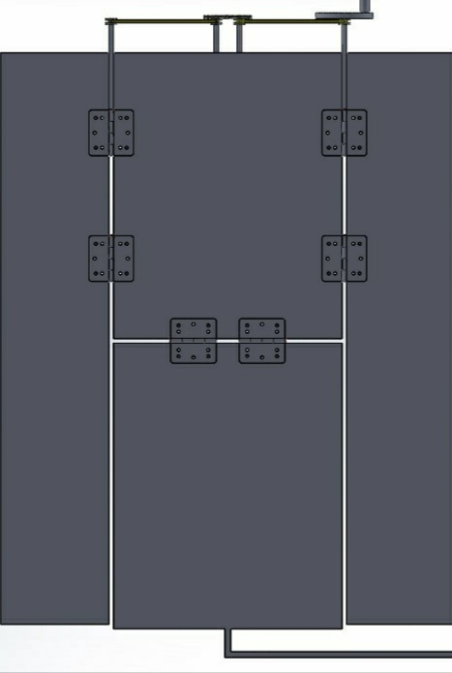
Concept Model of further Condensing

Slide 30
Thank You….

